Slide 1


Green Pace
Security Policy Presentation
Developer: Anthony Miranda Aponte
Notes:
Hello Everyone! My name is Anthony. I am going to talk to you guys about Security Policy and how important it can be for integrating into your software.

Slide 2

OVERVIEW: DEFENSE IN DEPTH
Why is a security policy needed?
Foundation for a secure system
Defines expectations and responsibilities
Mitigates human errors
How does it support DiD?
Define how the multi-layer security is applied
Ensures the security for network, cloud, host, and app
Notes:
Let’s start with an overview of defense in depth and why it would be needed in a security policy. It is the foundation for a secure system since it can define the expectations and responsibilities for how the software and data should be managed. A security policy can also lead to mitigating human errors as that is a big factor of vulnerabilities.
How does it support defense in depth though?
Well, it can define how multi-layer security is applied into the system. Also, referencing the diagram it ensures the security for network, cloud, host, and the app.

Slide 3
THREATS MATRIX
Probability | Severity
 | Low | Medium | High
Likely | STD-003-CPP |  | STD-005-CPP STD-004-CPP STD-008-CPP
Probable | STD-007-CPP STD-010-CPP |  | STD-001-CPP
Unlikely | STD-002-CPP | STD-009-CPP STD-006-CPP
Notes:
Here we have a threat matrix that can show us a couple of coding standards that I research that are rated from most severe to least. What does it all mean? You can see how on the left side of the Matrix there a probability is going from the least likely up to the most likely. On the right side, there is severity that goes from lowest to highest. This matrix can be used to see what would be most important for assessing a risk.

Slide 4
10 PRINCIPLES
Principles | Standards
Validate Input Data | STD-004-CPP, STD-005-CPP
Heed Compiler Warnings | STD-005-CPP, STD-006-CPP, STD-009-CPP
Architect and Design for Security Policies | STD-008-CPP
Keep It Simple | STD-002-CPP, STD-007-CPP
Default Deny | STD-003-CPP
Principles | Standards
Adhere to the Principle of Least Privilege | STD-007-CPP
Sanitize Data Sent to Other Systems | STD-005-CPP
Practice Defense in Depth | STD-004-CPP, STD-009-CPP
Use Effective Quality Assurance | STD-001-CPP, STD-006-CPP
Adopt a Secure Coding Standard | STD-003-CPP, STD-007-CPP, STD-009-CPP, STD-010-CPP
Notes:
These are 10 principles that can help categorize the coding standards we have done a risk assessment on. As you can look closer you can see the standards can have multiple categorizations for each of the principles.

Slide 5
CODING STANDARDS
Rule | Severity | Likelihood | Remediation Cost | Priority | Level
STD-005-CPP | HIGH | LIKELY | MEDIUM | P18 (HIGH) | 5
STD-004-CPP | HIGH | LIKELY | MEDIUM | P18 (HIGH) | 5
STD-008-CPP | HIGH | LIKELY | HIGH | P9 (HIGH) | 4
STD-001-CPP | HIGH | PROBABLE | MEDIUM | P12 (HIGH) | 4
STD-003-CPP | LOW | LIKELY | MEDIUM | P4 (MEDIUM) | 3
STD-009-CPP | MEDIUM | UNLIKELY | MEDIUM | P4 (MEDIUM) | 3
STD-006-CPP | MEDIUM | UNLIKELY | MEDIUM | P3 (LOW) | 3
STD-007-CPP | LOW | PROBABLE | MEDIUM | P3 (5LOW) | 2
STD-010-CPP | LOW | PROBABLE | HIGH | P2 (LOW) | 2
STD-002-CPP | LOW | UNLIKELY | MEDIUM | P2 (LOW) | 1
Notes:
On this next slide there is the risk assessment done on the 10-coding standard discussed. They have been rated from highest to lowest risk level based on combinations of severity, likelihood, remediation cost, and priority.

Slide 6
ENCRYPTION POLICIES
Encryption at rest
Protects data stored in databases
Applied with key management systems
Prevents unauthorize acess
Encryption in flight
Secures data across networks
Applied with secure network like HTTPS or secure API
Ensures data confidentiality during transmit
Encryption in use
Protects data while actively processing
Applied in memory encryptions for private data
Protects data from insider threats like Malware
Notes:
There are 3 types of encryption policies that we will talk about which are Encryption at rest, Encryption in flight, and Encryption in use. Encryption at rest protects data stored in databases or backups by encrypting where it rests. It should be applied with key management systems for secure access control. The reason for its use it helps prevent unauthorize access if physical media is stolen, which also is compliance with the GDPR.
Encryption in flight Secures data while it’s transiting across networks such as a server and a user. It should be applied with a secure network like HTTPS or secure APIs. The reason for use is that it helps ensure data confidentiality during transmission.
Encryption in use Protects data while it is being actively processed in memory. It should be applied by using memory encryptions for system handling private data. The reason for use is that it helps protect data from insider threats like malware and enables processing data without exposing it in plain text.

Slide 7
TRIPLE-A POLICIES
Authentication
Process of verifying identity
System uses a username and password
Prevent unauthorize user
Authorization
Determines what action and permission user has
Applies least privilege principle
Prevents abuse of access
Accounting
Tracks and logs actions performed by user
Used by network monitoring tool
Enables an incident response
Notes:
The triple-A policies play a big role in structuring a secure system. Authentication is the process of verifying the identity of a user or system before granting access. The authentication process works by systems using a username and password for accounts. The reason this policy applies is to prevent unauthorize users from accessing the system.
Authorization determines what actions and permission a user or system has after they have been authenticated. It applies by using the least privilege principle as users only get access to what they need. The reason it applies is because it helps prevent abuse of access and enforces segregation of duties like who approves what.
Accounting tracks and logs actions performed by a user or system. The application is used by network monitoring tools or application logs. The reason it applies is because it enables an incident response and helps detect insider threats.

Slide 8
Unit Testing
Unit testing is utilized for testing individual components in code such as a function, class, or method independent from the program.
The tests displayed were done through google test in C++ visual studios
ClearEraseColleciton
ResizingToZero
AlwaysFail
OutOfRangeExceptionThrown
Notes:
Unit testing is utilized for testing individual components in code such as a function, class, or method independent from the program. Some of the tests that we were able to accomplish through Google test are clear erase collection, resizing to zero, always fail, out of range exception thrown

Slide 9
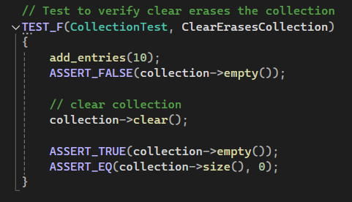
ClearEraseCollection
Test checks collection to verify that is empty
If not, it will clear the collection and check again for emptiness.
Notes:
Clear erase collection is a test that checks collection to verify that it is empty. If it is not empty it will clear the collection and check again for emptiness

Slide 10
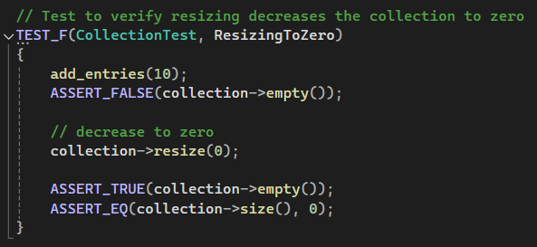
ResizingToZero
Test to check the collection is zero by check for emptiness
If it’s not empty, decrease to zero then check again.
Notes:
Resizing to zero is a test to check the collection is zero’d by checking for emptiness. If its not empty, it will decrease to zero then check again.

Slide 11
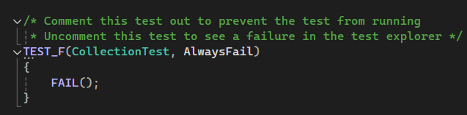
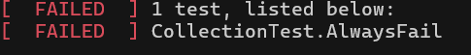
AlwaysFail
Test verifies that the unit test can flag fails.
Notes:
The always fail test is self-explanatory. The test verifies that the unit test can flag fails. Which you can see how it looks as the test result on the bottom.

Slide 12
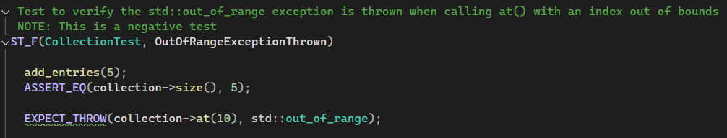
OutOfRangeExceptionThrown
Test verifies an exception is thrown when an index is out of bounds
Notes:
Out of range exception thrown test verifies an exception is thrown when an index is out of bounds

Slide 13

AUTOMATION SUMMARY
Notes:
This is a DevSecOps diagram breakdown how automation can be integrated into Devops to help convert into DevSecOps

Slide 14
TOOLS
Diagram shows visual representation of how DevOps converts to DevSecOps utilizing automation.
External Tools
CodeSonar
find issue early before deployment
Runs without manual intervention
Used during verify and test phase of Automation
Parasoft C/C++
analysis
Used continuously Automated static through the pipeline
Falco
Runtime Security (IDS)
Monitors suspicious activity during production
Notes:
The diagram shows a visual representation of how DevOps is converted to DevSecOps utilization automation. These are some of the tools that can be used for static analyzing or detecting vulnerabilities. CodeSonar finds issues early and can run without any manual intervention. Parasoft is widely used for analysis throughout the pipeline. Falco is a runtime security that monitors suspicious activity during the production phase.

Slide 15
RISKS AND BENEFITS
Risks for wait | Benefits of acting now
Expensive and extensive to fix Critical data breaches Missed vulnerabilities | Improves quality of software creating stability Efficient financially and timely Enhance customer trust
Steps to take
Create requirements with security in mind Threat modeling into use cases Apply the 10 principles discussed Validating input data Use guides like OWASP for secure coding
Notes:
It is risky to wait to establish security because it will not only be expensive but extensive to find the root of the cause. It will be prone to critical data breaches because of missed vulnerabilities during the testing phase. Some of the benefits of starting early is that it will improve the quality of the software, be efficient, and create trust with customers in the long run.
Here some steps to get started with.

Slide 16
RECOMMENDATIONS
Gaps in the Security Policy
Outdated versions of firewall
Lack of monitoring and auditing
Insufficient training or use of standards/guidelines
Recommendations
Follow compliant standards to maximize a stable structure to build upon
Create a routine for auditing and updating.
Utilize static analysis and detecting tools for vulnerabilities
Notes:
Some of the gaps that can harm the policy are outdated versions of firewall, lack of monitoring and auditing, and insufficient training because no use of standards.
Recommendations for mitigating all of this would be following standards to maximize a good stable structure. Create a routine to stay consistent with auditing codes and updating patches. Utilize the tools that can detect vulnerabilities.

Slide 17
CONCLUSIONS
Apply Defense in Depth in the system to create a fail-safe environment
Keep in mind that nothing is impenetrable
The earlier you start thinking secure the safer your software will be
Thank you for your time!
Notes:
In conclusion, make sure to apply defense in the system to create a fail-safe environment throughout the whole system. Please keep in mind that nothing is impenetrable, everything can be vulnerable at some point so stay on top of it. The earlier you start thinking secure the safer your software will be, so let’s start now. Thank you for your time!

Slide 18
REFERENCES
Berdyshev, A. (Jan 30, 2024). Why Software Security Should Be a Top Priority in Development. Medium. https://medium.com/@alex_berdyshev/why-software-security-should-be-a-top-priority-in-development-cca74072ef34
Davidson, E. (Sep 22, 2023). 10 of the most common security gaps, and how you can fix them. Celerity. https://celerity-uk.com/blog/10-of-the-most-common-security-gaps-and-how-you-can-fix-them/
Gillis, A. S. (2024, October 28). What is authentication, authorization and accounting (AAA)? Search Security. https://www.techtarget.com/searchsecurity/definition/authentication-authorization-and-accounting?utm
NSYS Group Team. (2025, March 21). Encryption for the three States of Data: Best Practices. NSYS Group. https://nsysgroup.com/blog/encryption-for-the-three-states-of-data-best-practices/?utm
SEI CERT C++ Coding Standard - SEI CERT C++ Coding Standard - Confluence. (n.d.). https://wiki.sei.cmu.edu/confluence/pages/viewpage.action?pageId=88046682

